Slide 1
CAD-IT IoT Centre NodeLinx Project: Calendar
V1.0 | 13 JUNE 2023
Didi Setiawan
IoT Application Engineer

Slide 2

Login Page
Login
ID
:
Confirm
Cancel
Country:

Slide 3
Login Page Extended
Login
ID
:
1000
Name
:
Position
:
Country
:
Confirm
Cancel
Country:

Slide 4
Landing Page
Currency
Calendar
Machine Utilization
Chat

Slide 5


Task 2 – Login Calendar: Calendar Mashup
Calendar
Month:
January
Year:
2020
Monday | Tuesday | Wednesday | Thursday | Friday | Saturday | Sunday
 |  | 1 | 2 | 3 | 4 | 5
6 | 7 | 8 | 9 | 10 | 11 | 12
13 | 14 | 15 | 16 | 17 | 18 | 19
20 | 21 | 22 | 23 | 24 | 25 | 26
27 | 28 | 29 | 30 | 31
Country:

Slide 6

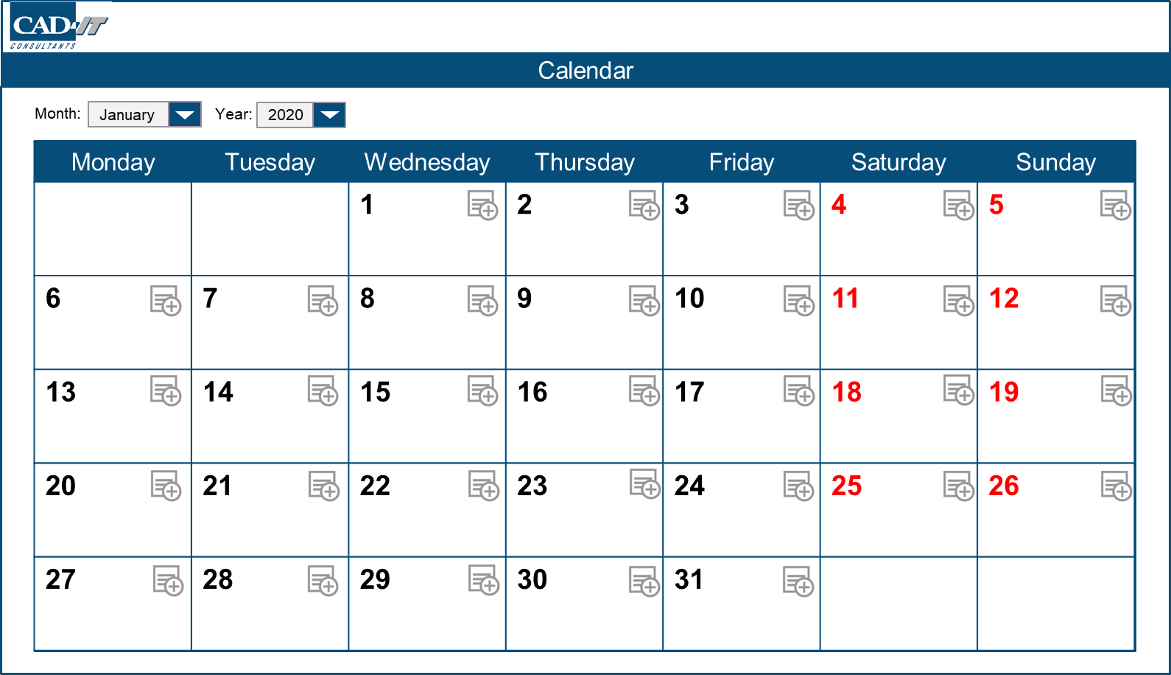
Task 2 – Login Calendar: Calendar Mashup
Title
Date:
16 January 2020
Test
Notes
Test note
Priority:
High
Add
Cancel

Slide 7
Task 2 – Login Calendar: Calendar Mashup
Test
Test
Test

Slide 8
Task 2 – Login Calendar: Calendar Mashup
Title
Date:
16 January 2020
Test
Notes
Test note
Priority:
High
Update
Delete

Slide 9
Task 2 – Login Calendar: Calendar Mashup
Title
Date:
16 January 2020
Test
Notes
Delete notes?
Test note
Confirm
Cancel
Priority:
High
Update
Delete

